Slide 1
HTML – Form

Slide 2
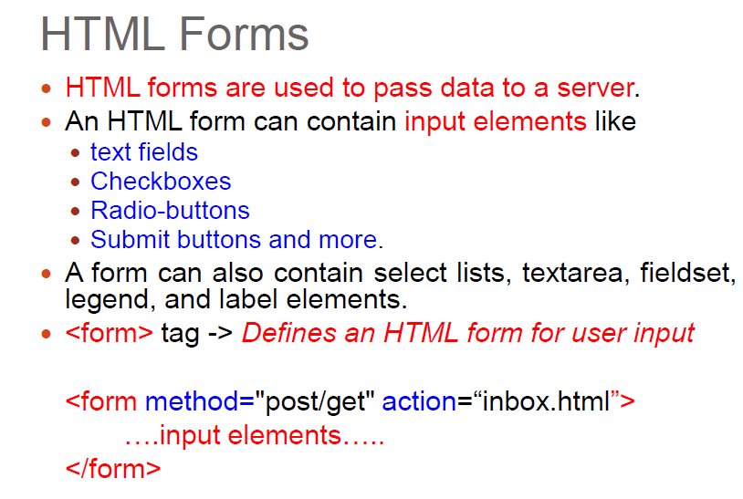
Question

Slide 3
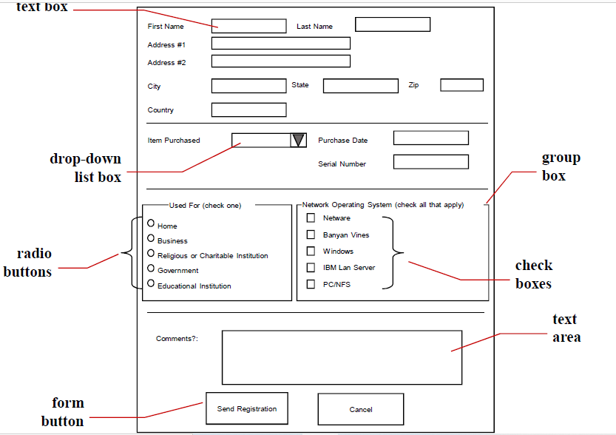

Slide 4
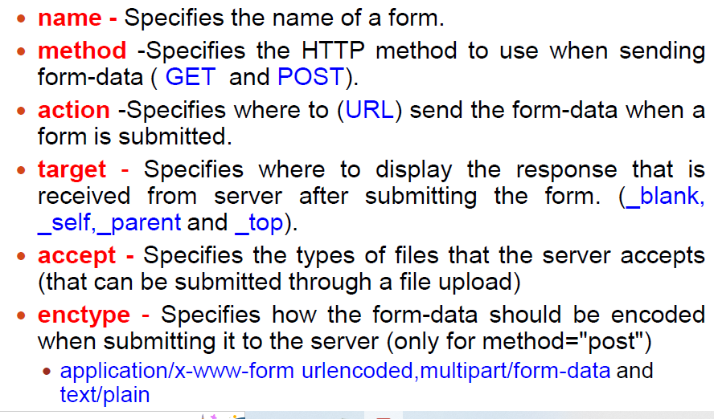
Form Attribute

Slide 5
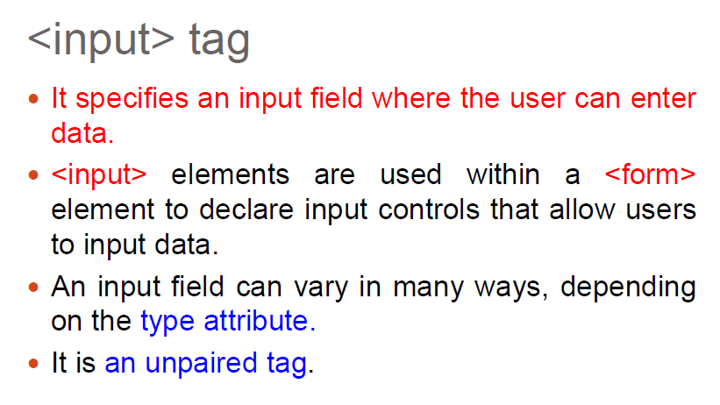
Input tag

Slide 6
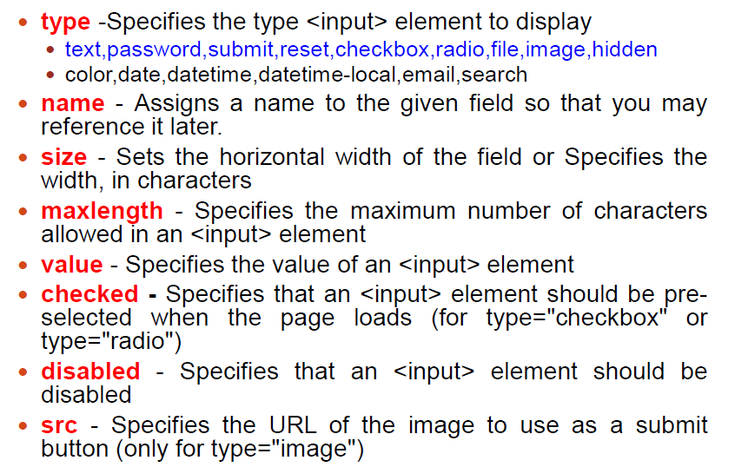
Input tag attribute

Slide 7
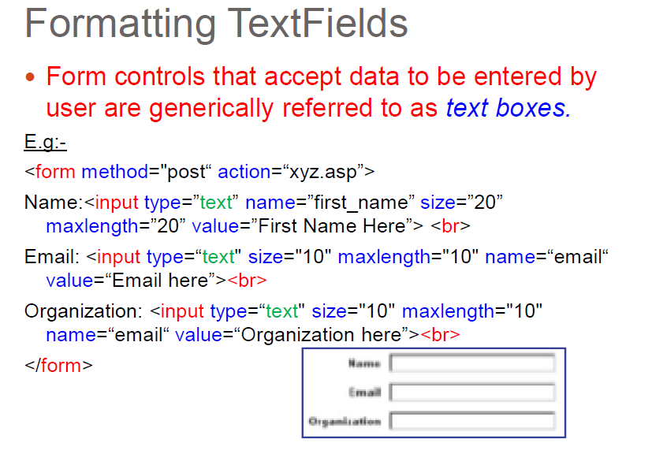
Text field

Slide 8
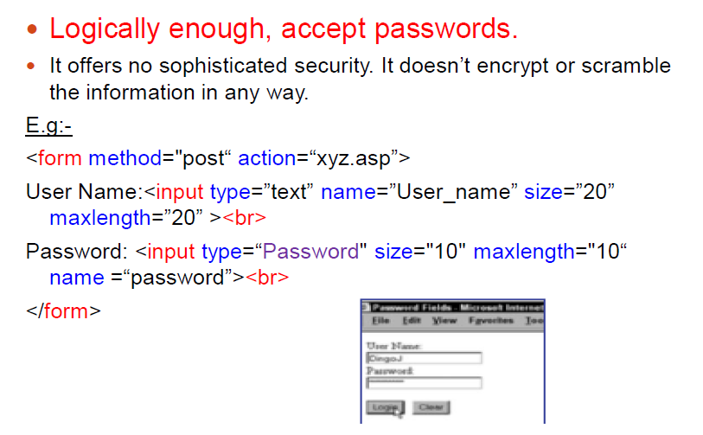
Password field

Slide 9
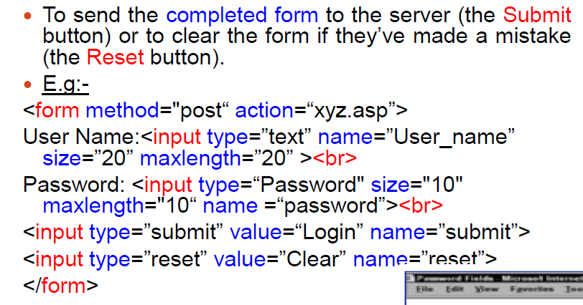
Form submit and reset

Slide 10
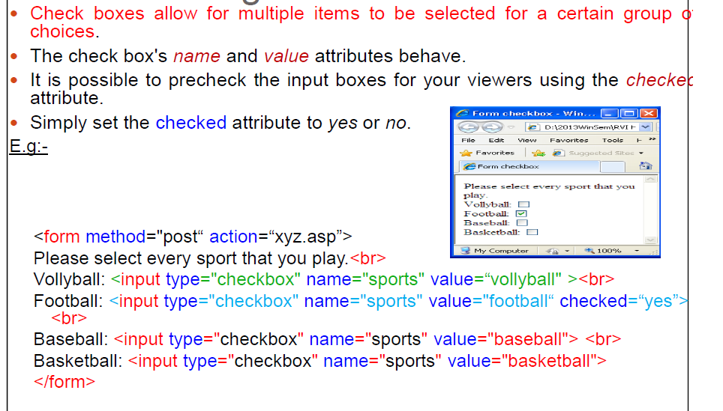
checkbox

Slide 11
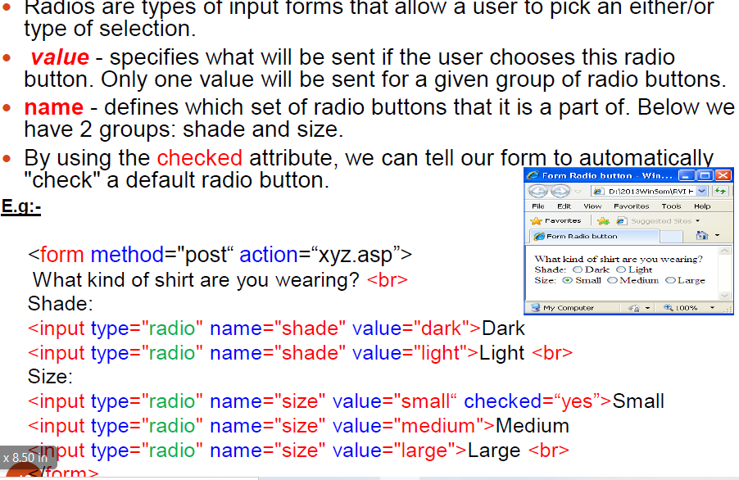
Radio Button

Slide 12
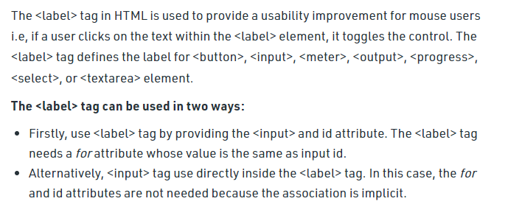
Label Tag

Slide 13
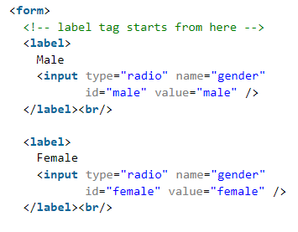
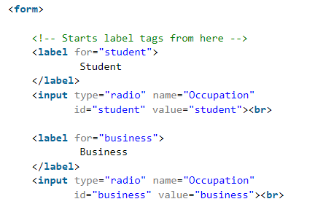
label

Slide 14
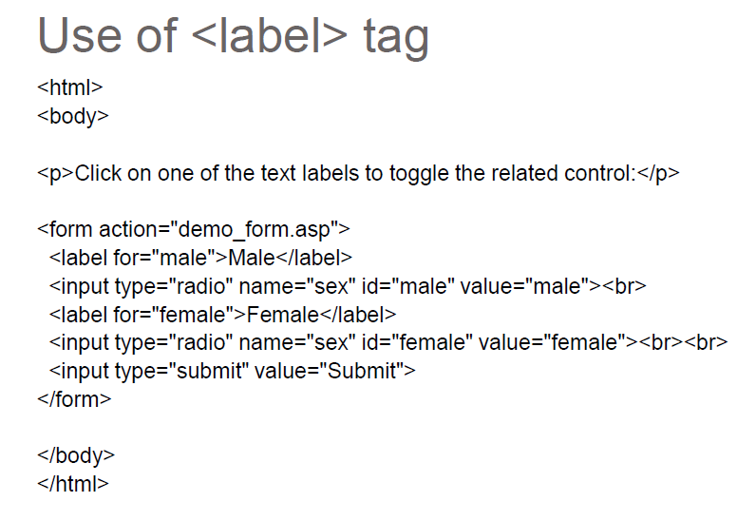
Label Tag

Slide 15
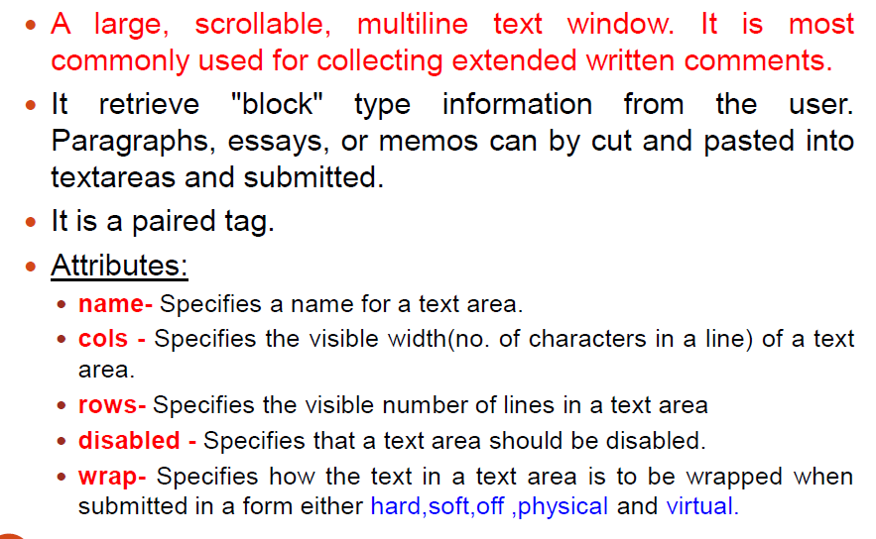
TextArea

Slide 16
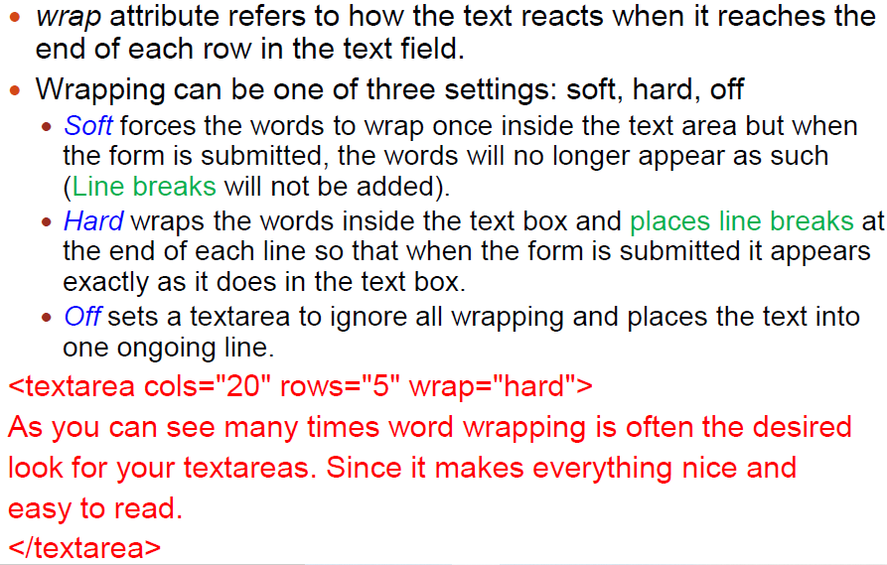
TextArea

Slide 17
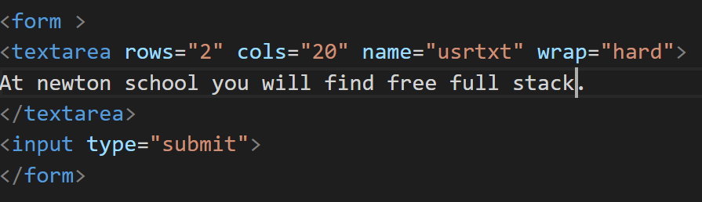
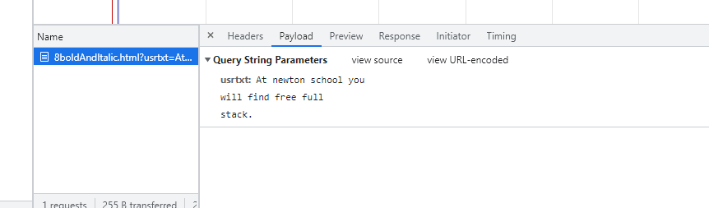
Wrap=“hard”

Slide 18
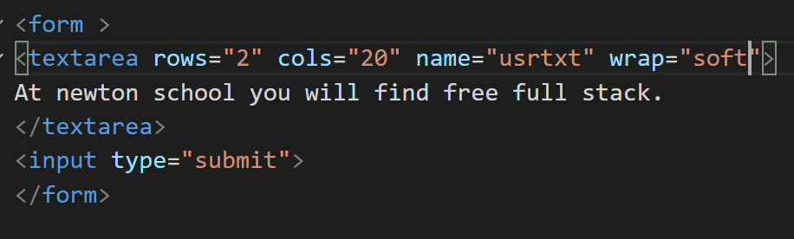
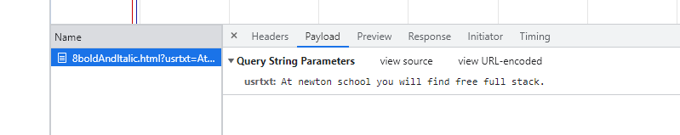
Wrap=“soft”

Slide 19
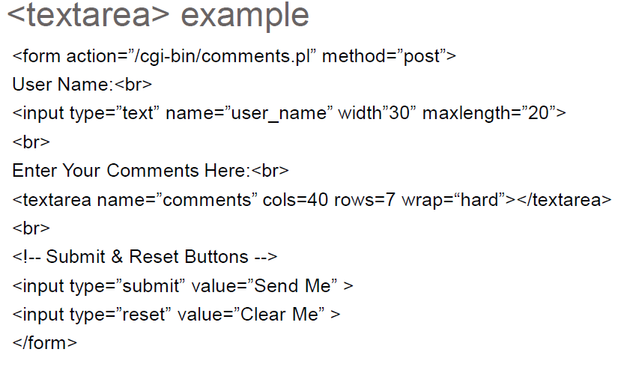
TextArea

Slide 20
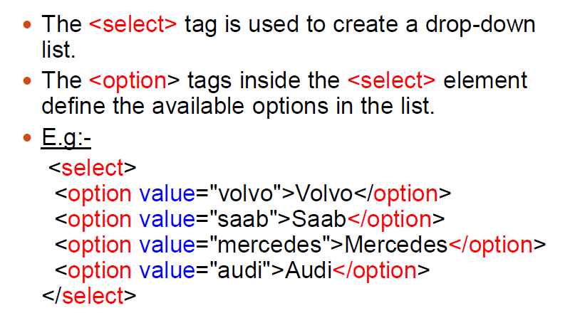
Select Tag

Slide 21
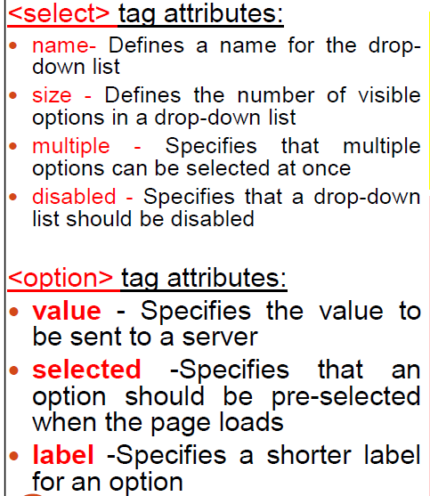
Select Tag

Slide 22
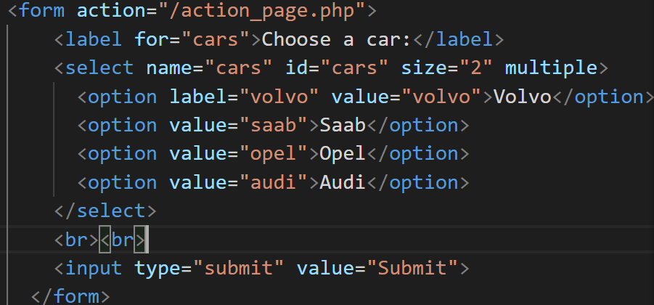
Select tag

Slide 23
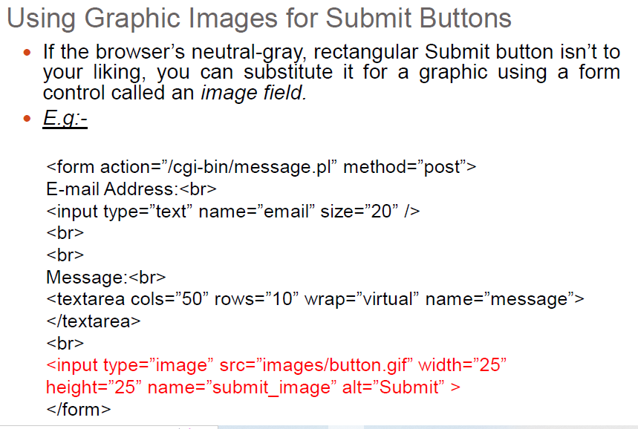
Image for button

Slide 24
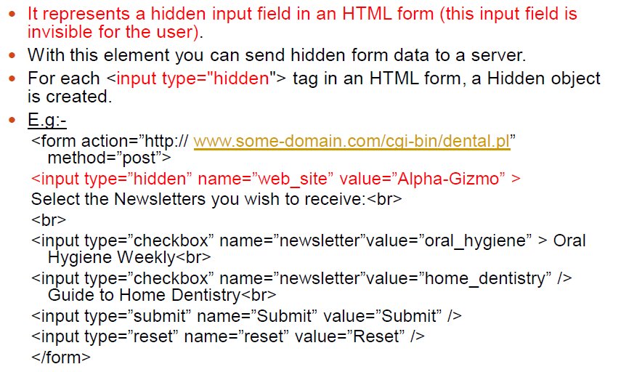
Hidden field

Slide 25
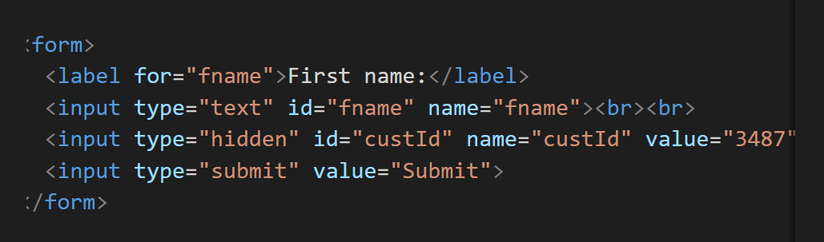
Hidden tag

Slide 26
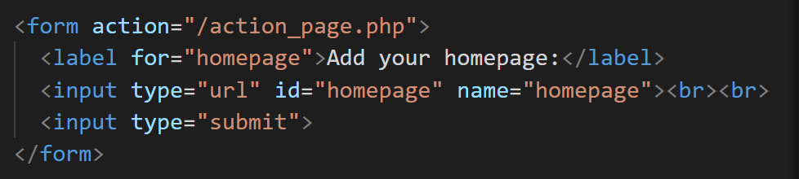
URL

Slide 27
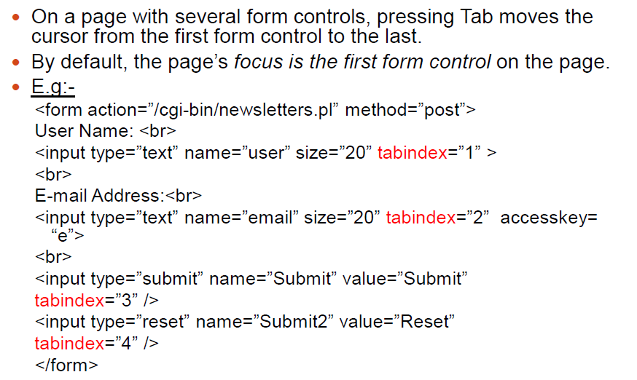
Focus Order

Slide 28
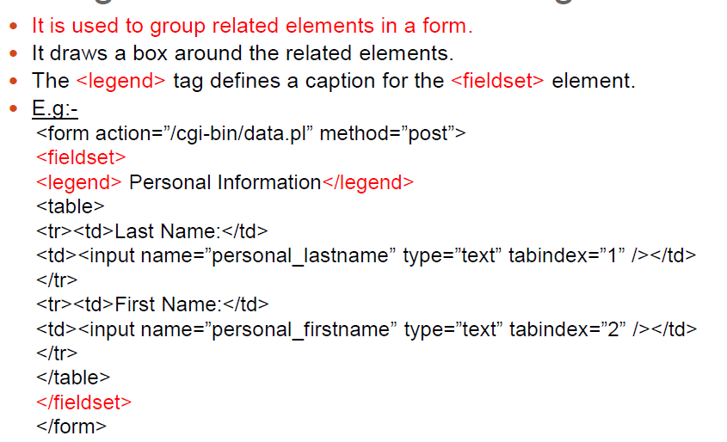
Fieldset

Slide 29
Frequent used input elements
<input type="button">
<input type="checkbox">
<input type="date">
<input type="email">
<input type="file">
<input type="number">
<input type="password">
<input type="radio">
<input type="reset">
<input type="submit">
<input type="text">

Slide 30
Element Specific Attributes continue..
Input Elements Attribute List:
value Attribute - <input type="text" id="fname" name="fname" value=“Ramesh">
readonly Attribute - <input type="text" id="fname" name="fname" value=“Ramesh“ readonly>
disabled Attribute - <input type="text" id="fname" name="fname" value=“Ramesh“ disabled>
maxlength Attribute - <input type="text" id=“mbl" name=“mobile" maxlength=“10">
minlength Attribute - <input type="text" id=“mbl" name=“mobile" minlength=“2">
Pattern Attribute:<input type="text" pattern="[A-Za-z]{3}" title="Three letter country code">
placeholder Attribute - <input type="text" id="fname" name="fname" placeholder=“Enter First Name">
required Attribute - <input type="text" id="username" name="username" required>
autofocus Attribute - <input type="text" id="fname" name="fname" autofocus>
selected Attribute - <option value=“chn" selected>Chennai</option>
checked Attribute - <input type="checkbox" name=“run" value=“running" checked>
Min - <input type=“number" name=“run" value=“running" min=“1” max=“5”>
Max <input type=“number" name=“run" value=“running" min=“1” max=“5”>

Slide 31
HTML Forms Method
GET:
Appends the form data to the URL, in name/value pairs.
NEVER use GET to send sensitive data! (the submitted form data is visible in the URL!).
The length of a URL is limited (2048 characters).
Useful for form submissions where a user wants to bookmark the result.
GET is good for non-secure data, like query strings in Google.
POST:
Appends the form data inside the body of the HTTP request (the submitted form data is not shown in the URL).
POST has no size limitations, and can be used to send large amounts of data.
Form submissions with POST cannot be bookmarked.

Slide 32
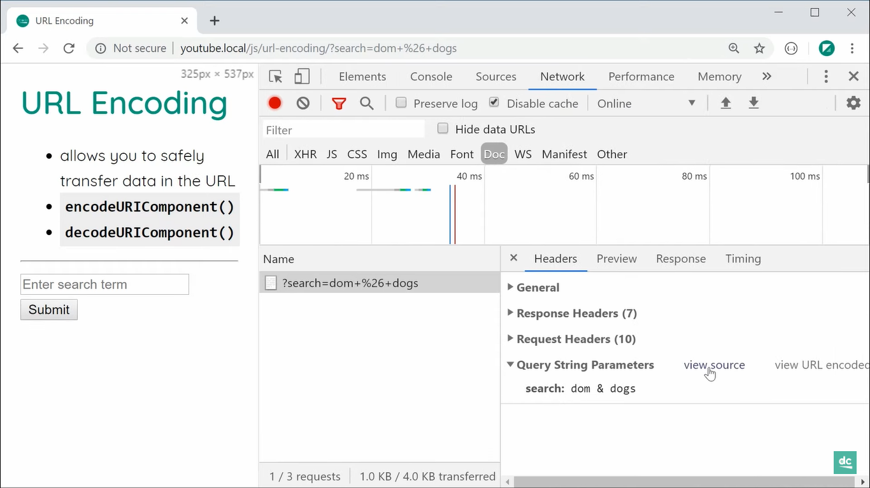

Slide 33
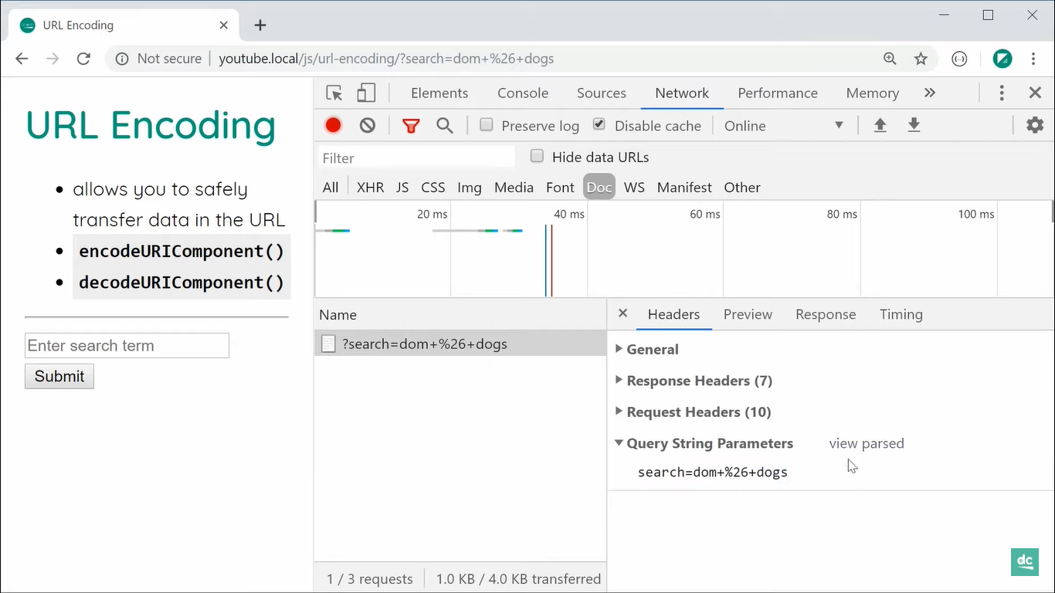

Slide 34
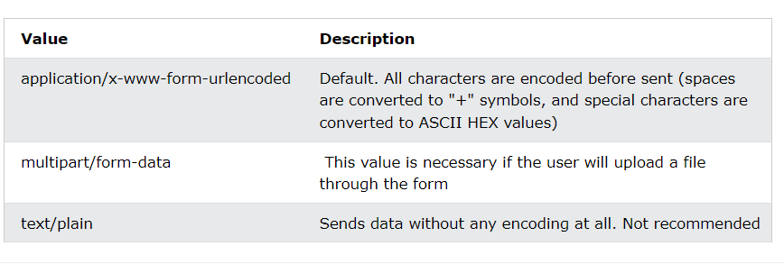
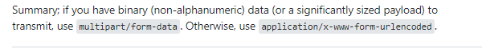
Form – enctype attribute

Slide 35
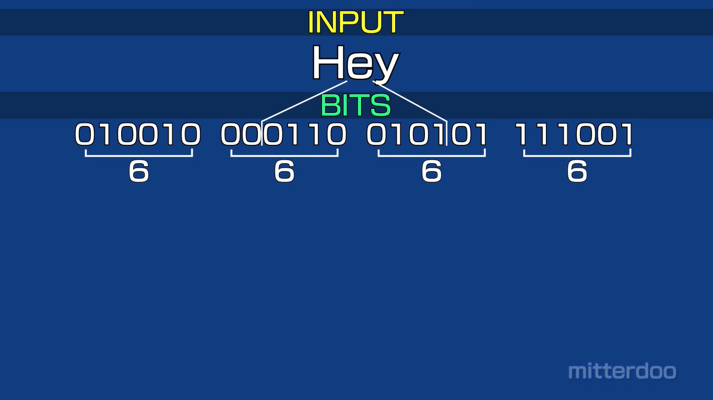
Base 64

Slide 36
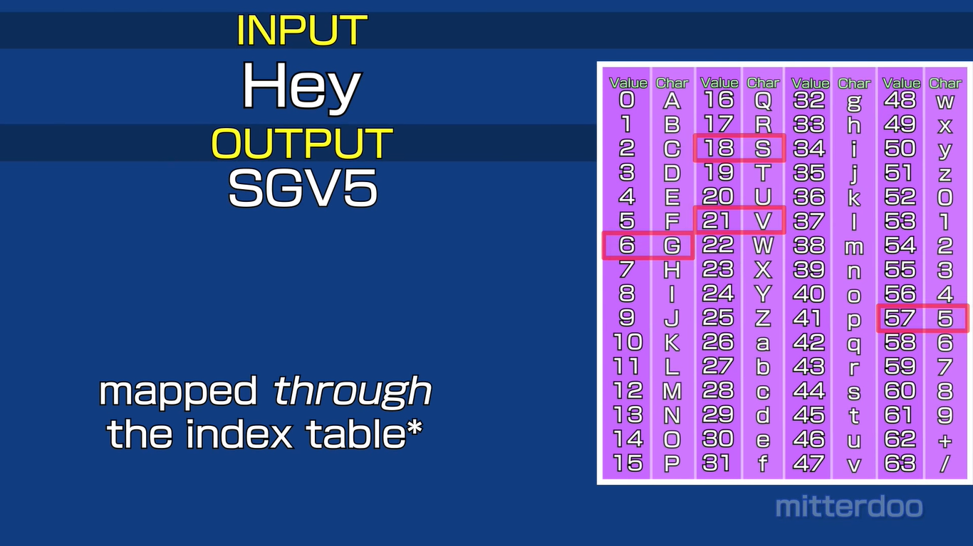
Base 64 – index table

Slide 37
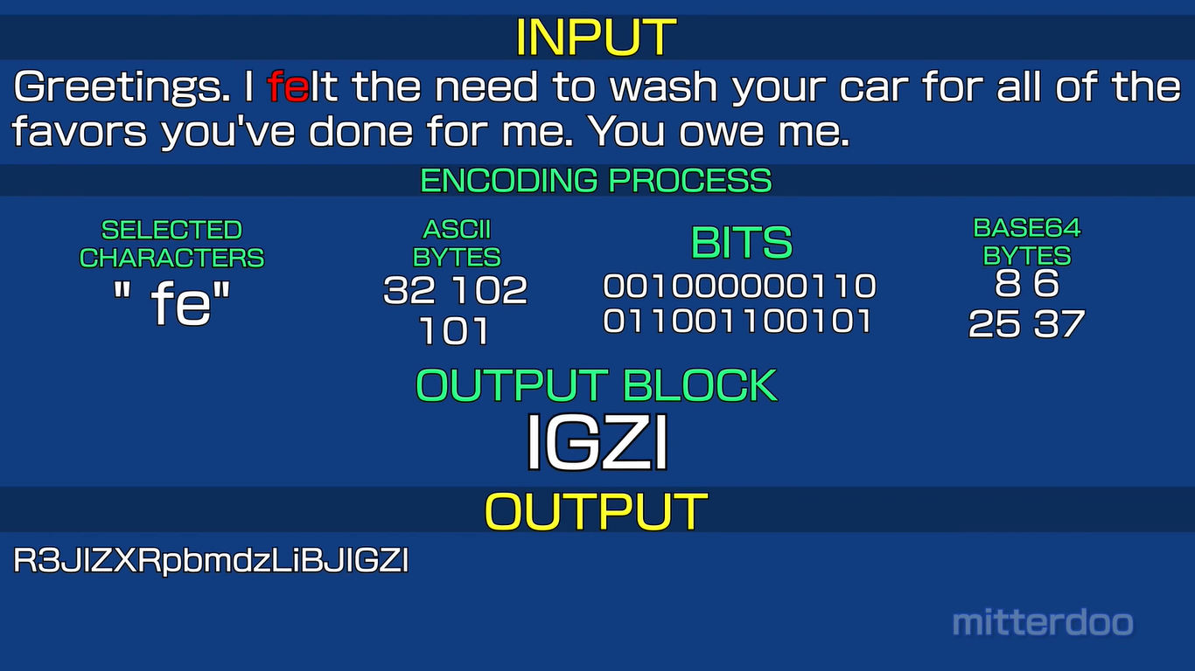
Base 64 format

Slide 38
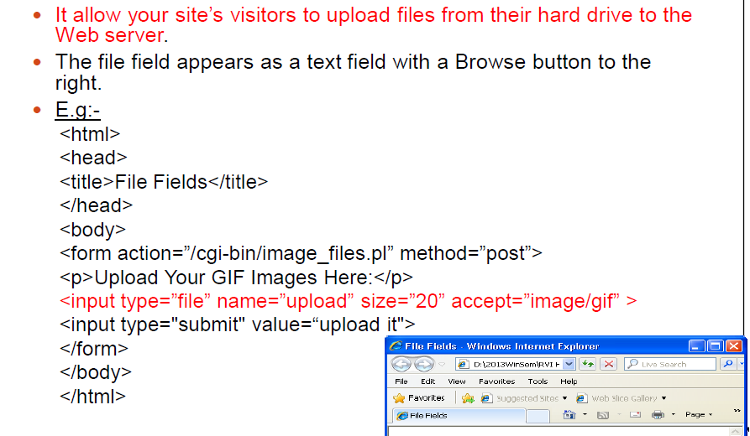
File Field

Slide 39
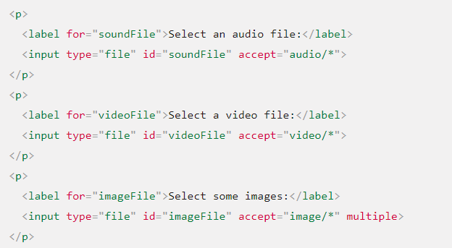
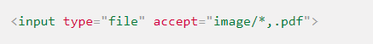
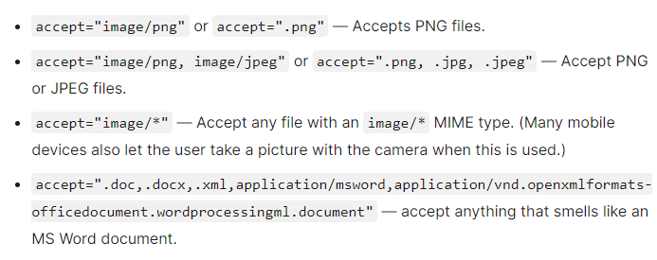
File Type

Slide 40
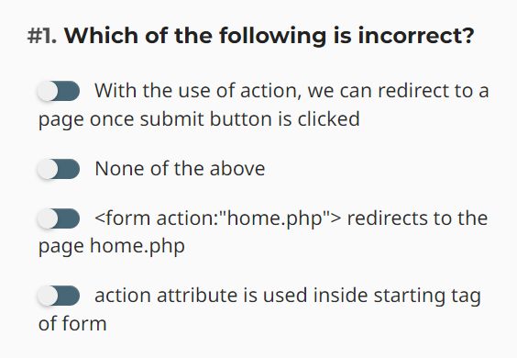
Question

Slide 41
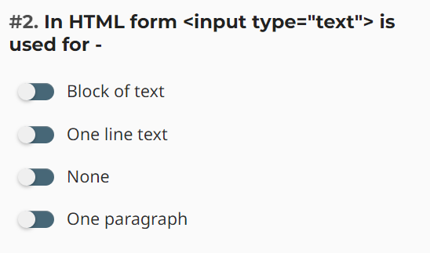
Question

Slide 42
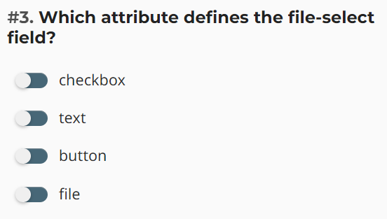
Question

Slide 43
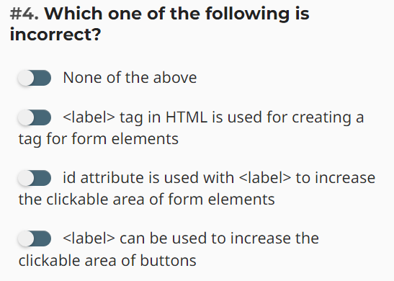
Question

Slide 44
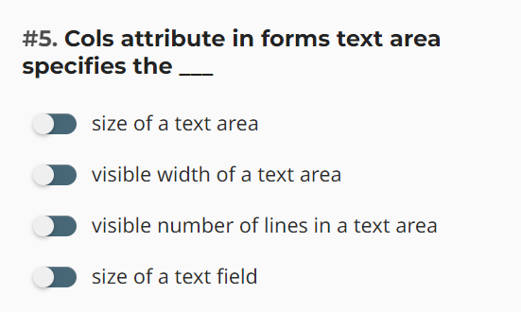
Question

Slide 45
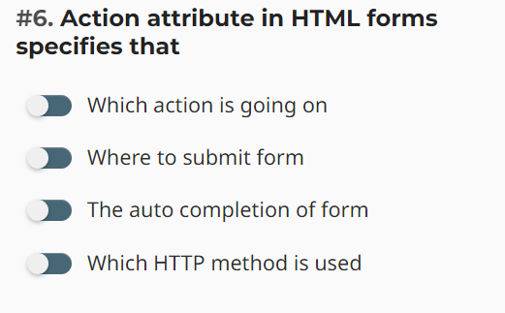
Question

Slide 46
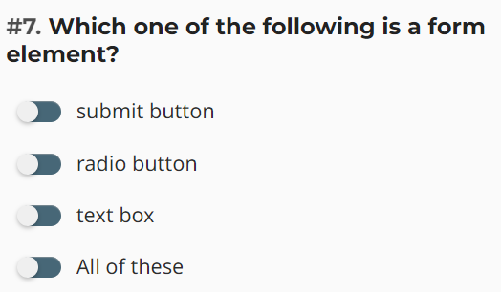
Question

Slide 47
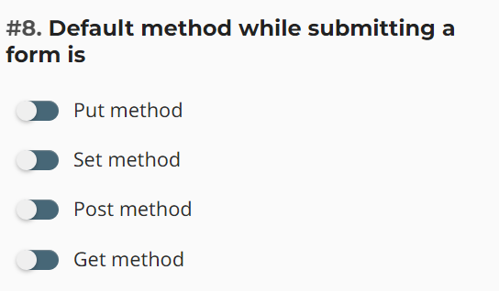
Question

Slide 48
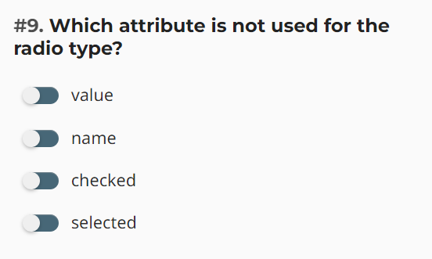
Question

Slide 49

Question

Slide 50

Question

Slide 51

Question

Slide 52

Question

Slide 53

Question

Slide 54

Question

Slide 55

Question

Slide 56

Question

Slide 57

Question

